Slide 1

BREAKING IMPASSE and more

Slide 2
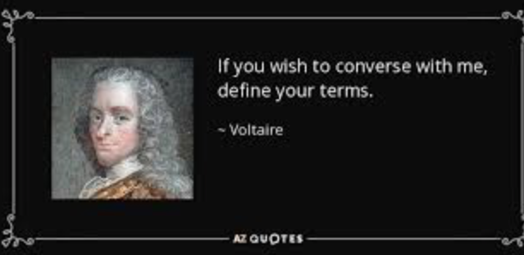
LET’S DEFINE TERMS – WHAT IS “IMPASSE”?
A place in the bargaining where people are stuck? When no one will make a move?

Slide 3

WHEN DOES THIS HAPPEN?
Early? “They aren’t here in good faith…”
Later? Usually…

Slide 4

IF IMPASSE IS THE DISEASE, WHAT ARE THE CURES?
Let ‘Em Stew
Decision Trees and Risk Analysis
Bracketing and Conditional Offers
Mediator’s Proposals
External Decision Maker for Stuck Points
Med-Arb
Recap, Break and Follow-up
Lots more…but…

Slide 5
CIRCUMSTANCES VARY DRAMATICALLY,
and there isn’t a single reason that explains all impasses.
  If we are to break the impasse, we need to understand what caused it. Kind of like – if we are to cure the disease, we need to have a hypothesis, and it will be based on symptoms.
  Once we have symptoms, we’ll get a sense of whether this is muscular, respiratory, circulatory, etc.

Slide 6

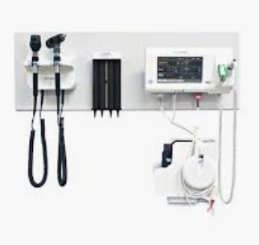
BUT FOR US, THE CANDIDATE GROUPS ARE:
Psychological Barriers
Strategic Barriers
Structural Barriers
Interpersonal Barriers
Cultural Barriers
Notes:
What’s in the hand? Diagnostic tools!

Slide 7
WHAT ARE EXAMPLES OF EACH?
Psychological – Reactive Devaluation or Confirmation Bias
Strategic – Stonewalling and/or Threats
Structural – Insufficient Authority or Bad Incentives
Interpersonal – Personality Disorders or Inadequate Communication Skills
Cultural – Generational or Identity

Slide 8

M&M
Let’s brainstorm or recapitulate and then discuss what the barrier to the successful resolution is and how to get there.

Slide 9

SO…WHAT’S COMING TO MIND?

Slide 10
LET’S REVISIT OUR EARLIER LIST OF CURES
Let ‘Em Stew
Decision Trees and Risk Analysis
Bracketing and Conditional Offers
Mediator’s Proposals
External Decision Maker for Stuck Points
Med-Arb
Recap, Break and Follow-up
Others?

Slide 11

QUESTIONS?

Slide 12


