Slide 1
TRAPS, TRENDS, TRICKS, AND TRIBULATIONS
OF WRITING REASONED AWARDS:
Part 1: Framing and Structuring the Award
JOHN BURRITT McARTHUR
LAW OFFICE OF JOHN BURRITT McARTHUR
presented at
JAMS San Francisco, CA
May 7, 2019 7:45 a.m.
with
RICHARD CHERNICK

Slide 2
WHAT WILL WE COVER THIS MORNING?
Part 1: Introduction [5 minutes]
Part 2: Background on Award Forms [5 minutes]
Part 3: Forms of Unreasoned Awards [15 minutes]
Part 4: Discuss All Claims, Defenses? [10 minutes]
Part 5: Discuss All Elements of Claims, Defenses? [10 minutes]
Part 6: Write Efficiently by Writing Narrowly [10 minutes]

Slide 3
PART 1:
INTRODUCTION

Slide 4
THE PERILS OF POWERPOINTS
(AND HOW WE WILL USE THESE SLIDES)
1.
1. Edward Tufte, The Cognitive Style of Powerpoint: Pitching Out Corrupts Within, https://www.edwardtufte.com/tufte/powerpoint: Attacks powerpoint for creating illusion of omniscience in speaker and squelching discussion.
2. [How lucky! Today’s speaker is omniscient!]
3. Texas Bar Cle instructions, 2015 “TIPS FOR POWERPOINT PRESENTATIONS”: Some important “don’ts”: Don’t drop beneath a 20 point font. . . . Don’t use more than 6-9 lines per page . . . Don’t use more than three bullet points per page. . . . Don’t use more than 40 words per page. . . . Don’t read your slides.

Slide 5
WHO AM I, TO TALK TO YOU?
1. Trial lawyer 36 years: Houston’s Susman Godfrey LLP; San Francisco’s Hosie McArthur LLP.
2. Arbitrator 25 years: AAA, CPR, Fed-Arb, LCIA, FINRA, HKIAC, and KLRCA.
3. Fellow, CCA, part of team that updated Chapter 12 (on Awards), in COLLEGE OF COMMERCIAL ARBITRATORS, GUIDE TO BEST PRACTICES IN COMMERCIAL ARBITRATION (4th ed. 2017).
4. Fellow, CIARB.
5. The Tom Brady Award and the Merit of Reasoned Awards, 7 Harvard Journal of Sports and Entertainment Law 147 (2017).

Slide 6
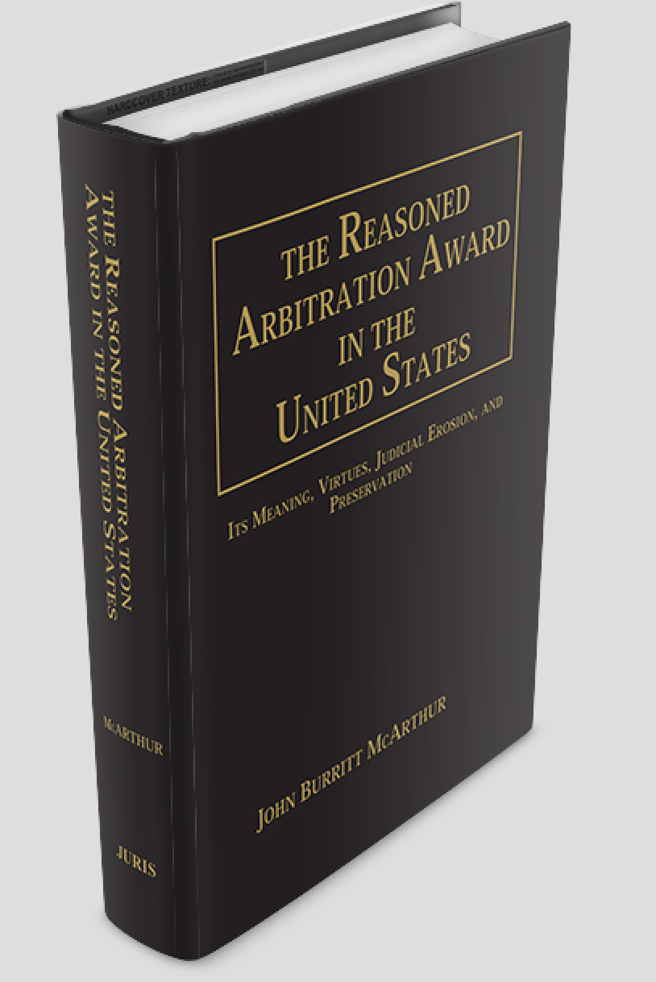
THE REASONED ARBITRATION AWARD
IN THE UNITED STATES:
(Juris Publications forthcoming fall 2019).

Slide 7
WHY I DECIDED TO STUDY
REASONING IN ARBITRATION AWARDS
In 36 years as a trial lawyer, 25 as an arbitrator, I
met too many arbitrators who tried to avoid giving reasons.
kept hearing that reasons make awards vulnerable, the opposite of what reasons do for a good judicial opinion.
disagreed with arbitrators who minimized reasons when they gave any at all.
was puzzled about why rules (domestic and international) do not define reasoned awards.
was stunned to learn the dominant standard of review for reasons in the United States almost guarantees that unreasoned awards will be confirmed as reasoned.

Slide 8

PART 2: BACKGROUND
ON SILENT (STANDARD) AWARDS
AND REASONED AWARDS

Slide 9
THE THREE MAIN FORMS OF AWARD
1. THE STANDARD AWARD: old U.S. domestic default.
  “First, of course, you have just the standard award, the old bullet points awards, where I give absolutely no reason for what we do, and it will just be a monetary amount, and who does this and that, and it will be on one page.”
    Quoting arbitrator in Rain Carbon CII LLC v. ConocoPhillips, 674 F.3d 469 (5th Cir. 2012).
2. THE REASONED AWARD:
    “. . . something short of findings and conclusions but more than a simple result.” Cat Charter LLC v. Schurtenberger, 646 F.3d 836, 844 (11th Cir. 2011).
    “ A ‘reasoned’ award [is] an award that is provided with or marked by the detailed listing or mention of expressions or statements offered as a justification of an act – the “act” here being, of course, the decision of the Panel.” Id.
3. FINDINGS OF FACT AND CONCLUSIONS OF LAW: less often used.
    “[A] relatively exacting standard familiar to the federal courts.” Id.

Slide 10
REASONED AWARDS ARE THE JAMS, CPR,
AND INTERNATIONAL DEFAULT FORM
1. JAMS Comprehensive Rule 24-h: “Unless the parties otherwise agree, the Award shall also contain a concise written statement of the reasons for the Award.”
2. CPR Admin. Rule 15.2: “All awards shall . . . state the reasoning on which the award rests unless the parties agree otherwise.” CPR Non-Admin. Rule the same.
3. UNCITRAL Model Law Article 31(2): “The award shall state the reasons upon which it is based, unless the parties have agreed that no reasons are to be given . . . .”

Slide 11
BUT THEY ARE NOT THE UNIVERSAL
DEFAULT IN DOMESTIC ARBITRATION
1. AAA Commercial Rule 46(b): “The arbitrator need not render a reasoned award unless the parties request such an award prior to the appointment of the arbitrator or unless the arbitrator determines that a reasoned award is appropriate.”
2. AAA many exceptions: AAA has many places where a reasoned award is its default form: (1) construction disputes $1 million and up, (2) consumer disputes, (3) employment disputes, (4) labor disputes,
(5) class actions, (6) appeals.
3. Practice: Most AAA arbitrators issue reasoned awards in big cases.
4. Standard awards: But, uniquely to the United States, the silent award still is called the “standard” award and is not uncommon.

Slide 12
WHY JAMS ARBITRATORS SHOULD
THINK ABOUT WHAT A REASONED AWARD IS
1. JAMS arbitrators will encounter disagreement on what “reasoned” requires when sitting on outside panels.
2. Judges are not always well trained to give reasons (see next slide).
3. Unreasoned “reasoned” awards damage arbitration’s legitimacy.

Slide 13
WHY SHOULD FORMER JUDGES LISTEN?:
YOU LIKELY HAVE BEEN
TRAINED TO RATION REASONS
1. Benjamin Cardozo, The Nature of the Judicial Process 164-65 (1921). Three categories re opinions:
(1) facts and law so obvious only judgment order needed;
(2) law clear though facts may be complex, unpublished nonprecedential opinion appropriate; and
(3) “not large” group of cases with legal uncertainty that deserve explained opinions.
2. Judge Aldisert endorses Cardozo’s basic approach in Ruggerio Aldisert, Opinion Writing 19-20 (2d ed. 2005).

Slide 14
THE FEDERAL JUDICIAL CENTER’S
WRITING MANUAL URGES DOING SO
1. Federal Judicial Center, Judicial Writing Manual: A Pocket Guide for Judges 5 (2d ed. 2013): Starts out well: “[o]pinions are written primarily for the litigants and their lawyers [the parties]” . . . [i]f an opinion is addressed to the parties, [it needs] a fair and accurate statement of what was before the court for decision, what the court decided, and what the reasons for the decision were.”
GREAT. BUT THEN?
2. Changes tune: Id. at 5-7: When opinions are “written
primarily for the parties, they will require little or no elaboration of the facts and law. . . . Often [such opinions] will take the form of summary orders or memorandum opinions. [Summary orders] sometimes include a brief statement of findings and conclusions, but often provide little or no explanation” . . . [Memorandum opinions] are generally brief and informal . . . ”(emphasis added).

Slide 15
RESULT?: EVEN GOOD JUDGES CAN THINK
ARBITRATORS NEED NOT ADDRESS
ALL CLAIMS AND DEFENSES
Judge Harvey Brown, concurring in Stage Stores, Inc. v. Gunnerson, 477 S.W.3d 848, 864, 872-73 (Tex. App. – Houston, 2015)(emphasis added):
. . . a “reasoned award” must offer some basic explanation for either rejecting the losing party’s key contentions or accepting the prevailing party’s opposing response unless the contentions are unclear, frivolous, their rejection is so conceptually straightforward that the justification for rejecting them is implied or unnecessary, or the rejection of the contention is implicit in other portions of the award.
Judge Brown is importing the resource scarcity and pressure in our courts into arbitration, costing arbitration one of its comparative advantages, the ability to provide a thoughtful reasoned award.

Slide 16
PART 3
FORMS OF UNREASONED AWARDS

Slide 17
THESE FORMS OF AWARD TOO OFTEN
SUBSTITUTE FOR REASONED AWARDS
SHORTCOMINGS EASY TO UNDERSTAND:
Announcement awards (e.g., list awards)
Attestation awards
Burden of proof, credibility awards.
SHORTCOMINGS NOT SO OBVIOUS:
4. Contention, issue spotting awards.
5. Evidentiary list awards.
6. Volumetric awards.

Slide 18
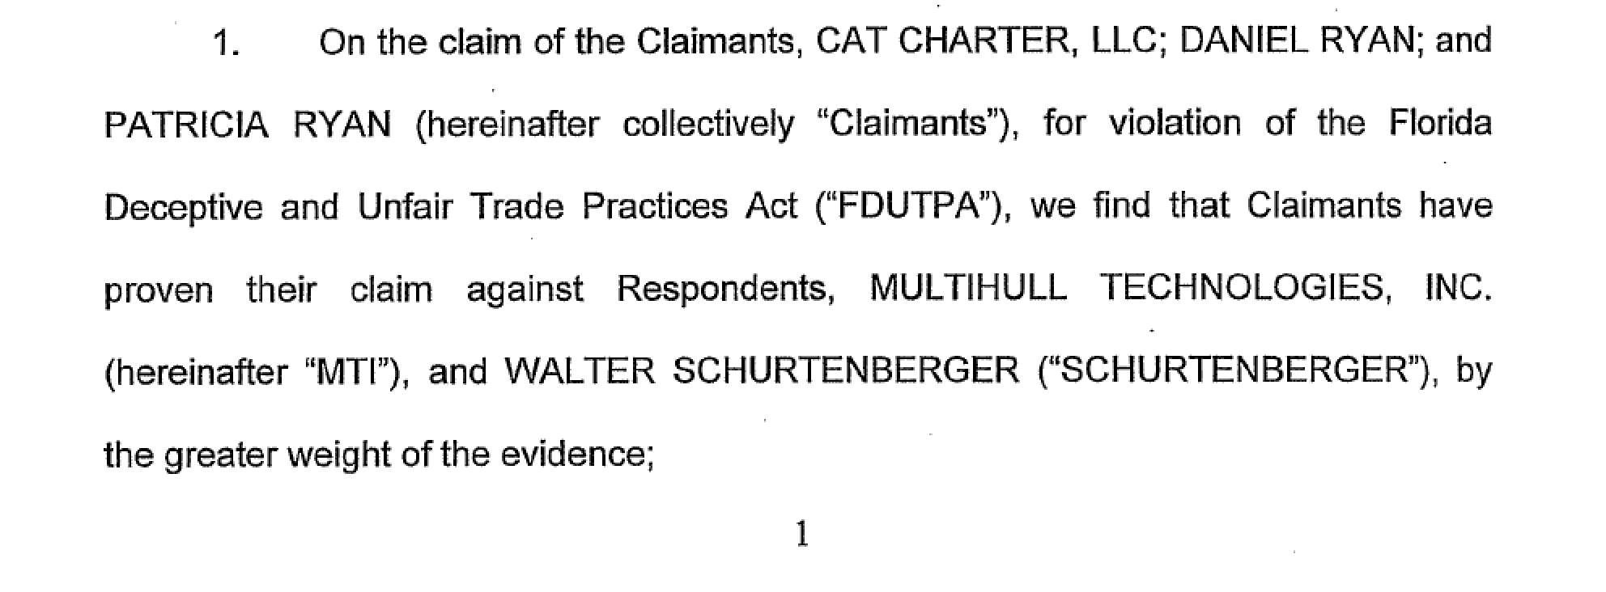
(1) ANNOUNCEMENT (3) BURDEN OF PROOF
UNREASONED AWARD (CAT CHARTER)
Discussion; what about the Cat Charter
award could be reasoned?
18

Slide 19
(2) ATTESTATION AND (4) CONTENTION
AWARD (RAIN CII CARBON)
[The winner’s contentions]: “Rain CII contends that the relief COP seeks should be denied because COP failed to show a condition precedent to arbitration – i.e., that the formula failed to yield a market level price for at least four quarters. As for the merits, Rain CII contends that the formula, whatever the result, is the “market” and thus it can never fail to yield a market level price. Rain CII further contends that the formula reflects a market level price because it has yielded a premium over Pace A. Accordingly, Rain CII contends that I should select the original formula as the replacement formula.”
[The “reasoning”]: “Based upon the testimony, exhibits, arguments, and submissions presented to me in this matter, I find that the price formula contained in Section 4 of the Green Anode Coke Sales Agreement dated August 23, 2005 . . . shall remain in effect for the balance of the term as stated in the contract.” (emphasis added)

Slide 20
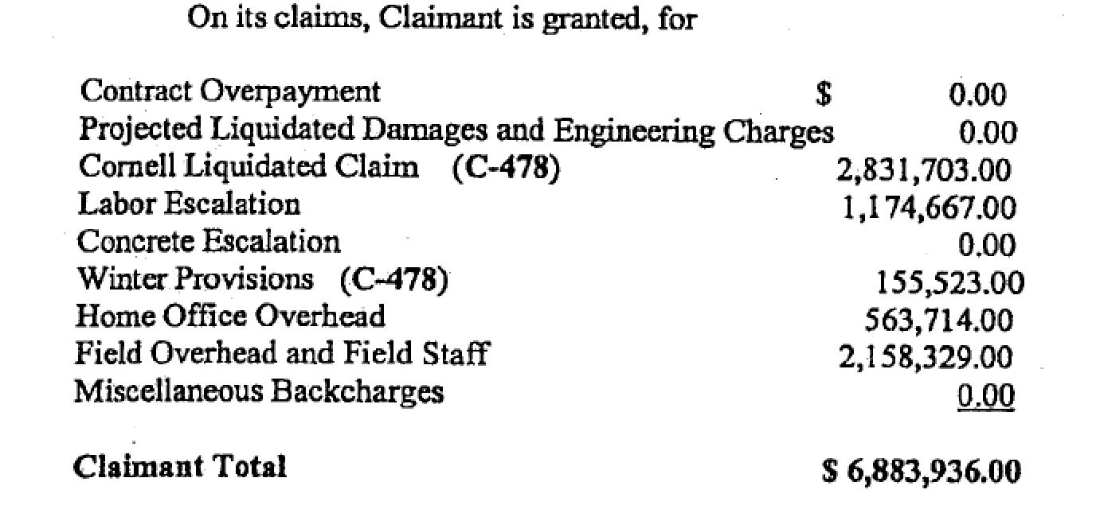
THE FIRST TULLY AWARD,
SUPPOSED TO BE REASONED,
WAS A LIST AWARD

Slide 21
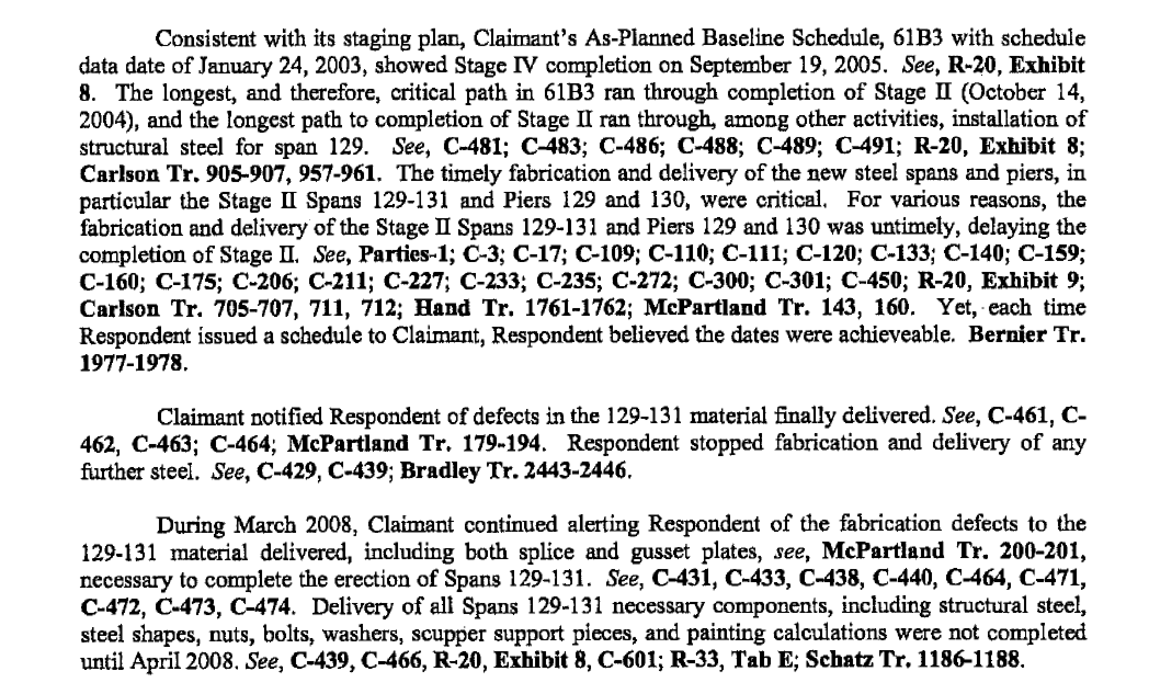
HERE IS THE SECOND TULLY AWARD
ARE THESE FACTUAL CONTENTIONS OR HOLDINGS?

Slide 22
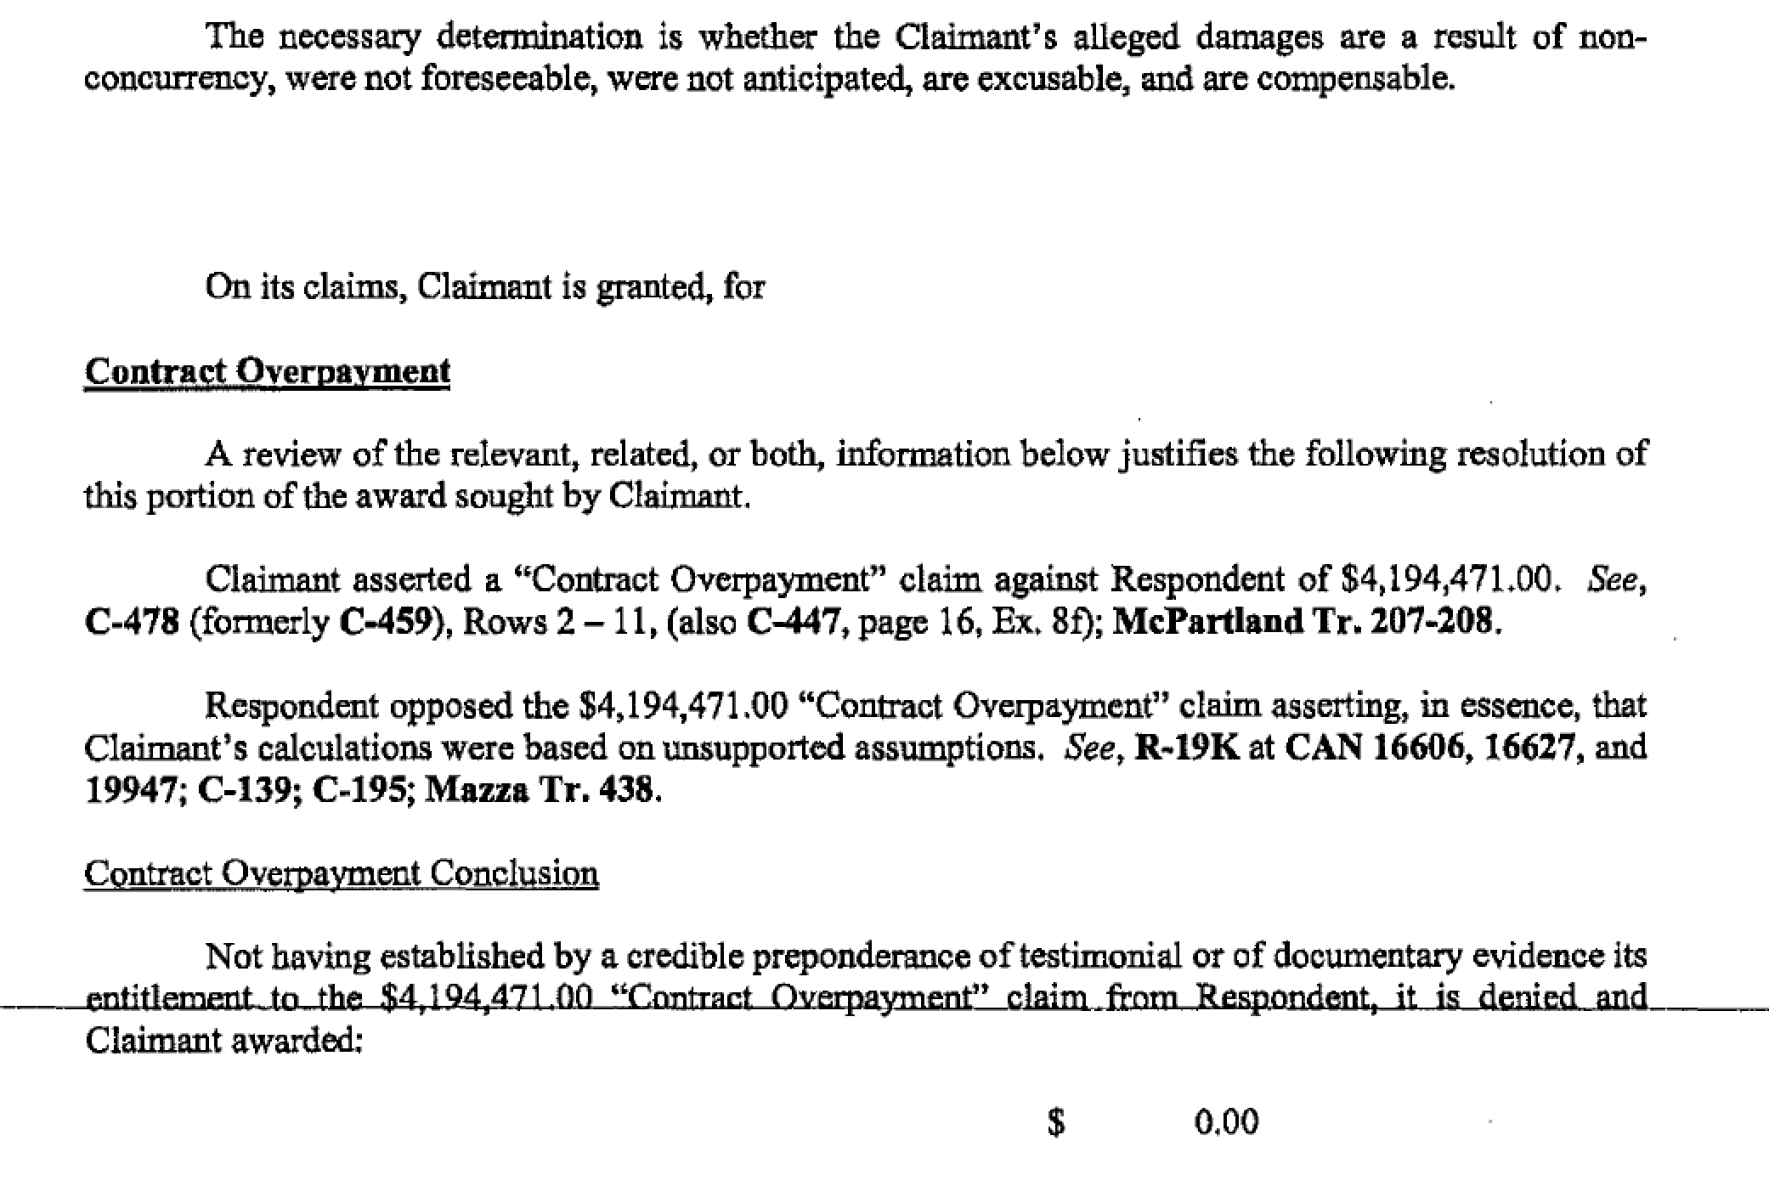
(2) ATTESTATION, (3) BURDEN OF PROOF(4) CONTENTION
(5) EVIDENTIARY LIST, (6) VOLUMETRIC AWARD

Slide 23
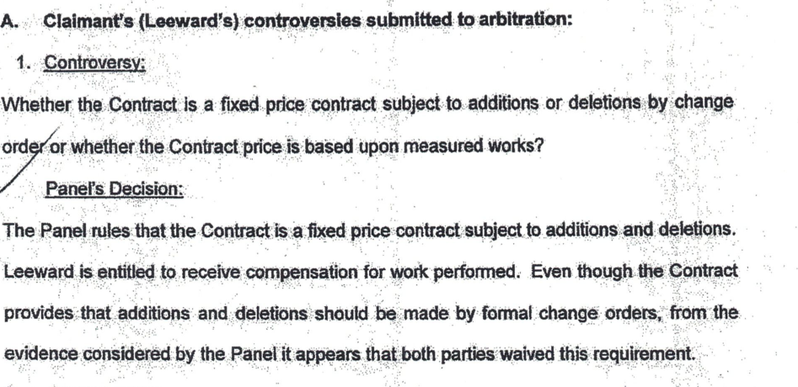
(6) VOLUMETRIC AWARD (LEEWARD):
ONE OF 69 “CONTROVERS[IES]” AND “DECISION[S]”

Slide 24
ATTACHED FILES WHERE YOU CAN
READ THE FULL AWARDS
AND CASELAW SUMMARIES
1. Cat Charter LLC v. Schurtenberger Award of Arbitrators: announcement, burden of proof award.
2. Rain CII Carbon v. ConocoPhillips Award of Arbitrator: contention, attestation award.
3. Tully Construction Co. v. Canam Steel Corp. Final Award of Arbitrator: announcement award (first award).
4. Tully Construction Co. v. Canam Steel Corp. Final Enlarged, Reasoned Award of Arbitrator: attestation, burden of proof, contention, evidentiary list, volumetric award (second award).
5. Leeward Construction Co. v. American University of Antigua – College of Medicine Final Award: volumetric award
6. Smarter Tools Inc. v. Chongqing SENCI Import & Export Trade Co., Ltd. Final Award, vacated by S.D.N.Y.. Mar. 26, 2019: attestation, burden of proof, credibility award.
7. Allison Snyder & John McArthur, Reasoned Awards Case Law Summary (presented at AAA/ICDR Panel Conference, Nashville, March 9, 2019).

Slide 25
WHAT HAPPENED TO THOSE AWARDS?
1. Cat Charter LLC v. Schurtenberger, 691 F.Supp.2d 1339, 1344 (S.D. Fla. 2010)(award vacated), vacatur rev’d based on implausible “reasoned” standard, 646 F.3d 836, 844 (11th Cir. 2011).
2. Rain CII Carbon LLC v. ConocoPhillips, 2011 WL 2565345 (E.D. La. 2011)(award confirmed), aff’d, 674 F.3d 469 (5th Cir. 2012).
3. Tully Construction Co. v. Canam Steel Corp., 2015 WL 906128 (S.D.N.Y.)(remanding for arbitrator who had refused to provide reasons to give reasons), 2016 WL 8943164 (affirming “Final Enlarged, Reasoned Award” issued after remand), aff’d, 684 Fed. Appx. 24 (2d Cir. 2017).
4. Leeward Construction Co. v. American University of Antigua – College of Medicine, 2013 WL 1245549 (S.D.N.Y. 2013)(award confirmed), aff’d, 826 F.3d 634 (2d Cir. 2016).
5. Smarter Tools, Inc. v. Chongqing Senci Import & Export Trade Co., LTD., 2019 WL 1349527 (Mar. 26, 2019 S.D.N.Y.)(late March opinion remanding for arbitrator to specify reasons).

Slide 26
PART 4:
DISCUSS
ALL POTENTIALLY DISPOSITIVE
CLAIMS AND DEFENSES

Slide 27
TO BE LEGITIMATE, BE SURE THE AWARD
ANSWERS THE QUESTIONS RAISED BY
THE PARTIES’ PRESENTATIONS
1. Parties are in arbitration because they could not see the world the same way. They deserve your help to resolve the things they thought too important to settle.
2. Therefore: Make sure award describes and decides what the parties think is important.
3. Have award address the parties’ questions, even if you ultimately conclude that different questions are the dispositive questions.
Knowing how to listen to the parties in order to define what must be decided is one of the most valuable arbitrator skills.

Slide 28
EXPLAIN RULING ON EVERY
POTENTIALLY DISPOSITIVE CLAIM, DEFENSE
1. Give reasons on each claim and defense that might have changed the outcome (the “potentially dispositive” claims and defenses).
2. Explain cumulative claims, even if in diminishing detail.
3. Remember: “second line” claims and defenses cannot save an award if not addressed, when first-line claim or defense is vacated.
4. Courts will imply any basis to save a standard award, but not a reasoned award (at least, they should not).

Slide 29
EXPLAIN RULINGS ON DEFENSES
1. Most defenses lose and losing defenses tend to be ignored.
2. Yet defenses have equal power to claims. A successful defense defeats a claim, just as a successful claim overcomes defenses.
3. Decide cumulative defenses, just like cumulative claims.
4. Proliferation of defenses should not lead to rejection by implication; give reasons. Were some defenses abandoned (no evidence, not in posthearing brief)? Was there no evidence of intentional relinquishment to support waiver? Did party claiming estoppel not change its position in reliance upon anything the other side said? . . .
5. Clarify by order for more definite statement.

Slide 30
EXPLAIN DISPOSITION OF
LOSING CLAIMS AND DEFENSES
1. Awards tend to focus on prevailing claims.
2. But a losing claim or defense on average is likely to matter to affected party as much or more than a winning claim or defense.
3. The losing party is the one likely to appeal; you must explain what happened to their case when writing a reasoned award.
4. Losing claims and particularly defenses often not even named in award; hard to think of a better way to anger losing party.

Slide 31
EXPLAIN AUTHORITY AND RATIONALE
FOR DECISIONS BASED ON
EQUITY, CREDIBILITY, FAIRNESS
1. “We can always do equity” too often an excuse to not observe limits on powers or applicable law on merits or on powers.
2. California law gives arbitrators broad power to go outside the law on the merits and remedies, but parties probably do not expect pure equitable treatment.
3. Don’t let emotion that one side was more credible, or a certain remedy “seems right,” or that a contract probably did not intend a result, blind you to the need to explain what in the evidence produced those reactions.
4. Test your emotional reactions v. the agreement, the evidence, and the law. That is what the rule of law requires of you.

Slide 32
REJECT IMPLIED REASONS,
AND EXCUSES FOR NOT EXPLAINING:
DON’T ACCEPT THIS STANDARD
Concurring Judge Harvey Brown, concurring in Stage Stores, Inc. v. Gunnerson, 477 S.W.3d 848, 864, 872-73 (Tex. App. – Houston, 2015)(emphasis added):
. . . a “reasoned award” must offer some basic explanation for either rejecting the losing party’s key contentions or accepting the prevailing party’s opposing response unless the contentions are unclear, frivolous, their rejection is so conceptually straightforward that the justification for rejecting them is implied or unnecessary, or the rejection of the contention is implicit in other portions of the award.
Judge Brown is importing the resource scarcity and pressure in our courts into arbitration, costing arbitration one of its comparative advantages, the ability to provide a thoughtful reasoned award

Slide 33
AND DON’T THINK COURTS WON’T VACATE
IF YOU OMIT TO EXPLAIN A CLAIM OR DEFENSE
IN A REASONED AWARD
1. Galloway Construction, LLC v. Utilipath, 2014 WL 3965119 (E.D.N.Y. 2014)(parties required arbitrators to “[a]nalyze the issues, claims, counterclaims, and defenses of the parties” and issue “reasoned award”; court vacated and remanded award that ignored two counterclaims).
2. Stage Stores Inc. v. Gunnerson, 477 SW.3d 848 (Tex. App. – Houston (1st Dist.) 2015) (remanded to arbitrator to address notice-and-cure affirmative defense when reasoned award required).

Slide 34
PART 5:
DISCUSS THE DISPUTED ELEMENTS
OF CLAIMS AND OF DEFENSES

Slide 35
EXPLAINING A CLAIM OR DEFENSE MEANS
EXPLAINING EVERY (1) DISPUTED (2) ELEMENT
1. Good courts know what to do: Alliance Mortgage
Co. v. Rothwell, 10 Cal. 4th 1226 (1995): “The necessary elements of fraud are: (1) misrepresentation . . .; (2) knowledge of falsity (scienter); (3) intent to defraud (i.e., to induce reliance); (4) justifiable reliance; and (5) resulting damage [citations omitted]. Only the last two elements are at issue.”
2. Be efficient identifying elements in dispute.
3. But: you MUST address and explain your resolution of those disputed elements in any reasoned award.
4. Failure to explain disposition of each element in dispute invites appeal.

Slide 36
NOT JUST CLAIMS AND DEFENSES:
DEAL EXPRESSLY WITH
CHALLENGES TO YOUR POWER
1. Jurisdiction and authority: Were arbitrators reading source of their powers, agreement, submission, rules, the law, or otherwise?
2. “[The court] is confined to ascertaining whether the party seeking arbitration is making a claim which on its face is governed by the contract. Whether the moving party is right or wrong is a question of contract interpretation for the arbitrator.” United Steelworkers of Am. v. American Mfg. Col., 363 U.S. 564,567 (1960)(emphasis added).
3. “The arbitrator may not ignore the plain language of the contract; but the parties having authorized the arbitrator to give meaning to the language of the agreement, a court should not reject an award on the ground that the arbitrator misread the contract.” United Steelworkers of Am. v. Enterprise Wheel & Car Corp., 363 U.S. 593, 597 (1960)(emphasis added; citation omitted).
4. Conclusion: The best way to protect award from attack on arbitrator powers (usually exceeded powers attack) is to give reasons showing you were reading the agreement.

Slide 37
EXPECT RULINGS ON FEES,
DAMAGE COMPUTATIONS, INTEREST,
TO BE CHALLENGED
1. Disproportionate number of appeals on fees.
2. Arbitrators often sympathize with prevailing party yet have no authority to award fees.
a. Black Hills Surgical Physicians LLC v. Setliff, 855 N.W.2d 407, 408-13 (S.D. 2014)(arbitrator injected derivative action theory in order to award fees to party when contract said parties were to bear their own fees).
b. Guardian Builders, LLC v. Uselton, 154 So.3d 964, 968-70, 972-74 (Ala. 2014)(arbitrator similarly tried to override contract’s making parties bear their fees to render BBB “fair and just” decision.
3. AAA rule that if both parties seek fees, arbitrators award them is rooted in common-law principles.
4. Factors to balance are American Rule, the agreement, applicable state or federal law, and impact if both parties’ asking for fees.
5. Explain conclusions on damage computations, interest – give courts some reasoning to which they can defer.

Slide 38
IF AN OUTCOME IS
ODD, COUNTERINTUITIVE, OR SURPRISING,
DOUBLE-CHECK YOUR LOGIC
1. S.M.H., 523 S.W.3d 783, 788-90 (Tex. Ct. App. – Houston [14th Dist.] 2017): Arbitrator instructed ruling on child support would be binding but not decision on possession, nonetheless issued a purportedly binding award on possession and exceeded powers.
2. Bound Brook Bd. of Educ. v. Ciripompa, 228 N.J. 4, 6-9, 13-18 (2017): Arbitrator asked to decide contract claim on “conduct unbecoming” exceeded powers by treating claim as much-harder-to-prove hostile work-environment claim.
3. Nassau Health Care Corp. v. Civil Service Emps. Ass’n, 83 A.D.3d 719, 720-21 (N.Y. App. Div. 2011): Arbitrator exceeded powers by reinstating employee even though a prior agreement provided for her termination if she violated conditions that arbitrator found she had violated.
4. Slocum v. Macaraga, 123 A.D.3d 1046 (N.Y. App. Div. 2014): Arbitrator asked to award $34,920 exceeded powers by awarding $43,000 instead, for no visible reason .

Slide 39
PART 6:
WRITE EFFICIENTLY BY WRITING NARROWLY

Slide 40
YOU MUST DECIDE
THE LENGTH AND DETAIL
OF A REASONED AWARD CONSCIOUSLY
On average award length should be set by:
1. The parties’ requests and desires.
2. The amount at stake.
3. The number of claims, defenses, and underlying arguments.
4. The number of exhibits and amount of testimony.
5. Substantive complexity (on facts or law).
6. The ultimate closeness of issues (shape of facts and law).
7. The likelihood of appeal, including contentiousness of the parties.

Slide 41
REASONED AWARDS NEED NOT BE COSTLY, SLOW
TO WRITE, OR MUCH DELAY FINALITY
Criticisms like the following ignore your power to adjust your writing to the needs of each arbitration:
1. “The arbitrator’s freedom not to explain [is] regarded as fundamental to the concept of efficient and economical dispute resolution and is an integral aspect of the strictly limited review accorded awards.” III IAN MACNEIL et al., FEDERAL ARBITRATION LAW: AGREEMENTS, AWARDS, AND REMEDIES UNDER THE FEDERAL ARBITRATION ACT § 37.4.1, at 37:12 (1994 & Supp. 1999)(emphasis added).
2. “Most arbitrators shun written opinions which boost the work load, add cost, and expose the award to risk of vacatur.” 3 THOMAS OEHMKE & JOAN BROVINS, COMMERCIAL ARBITRATION § 118.4, at 118-5 to -6 (3d ed. 2017).

Slide 42
CHOOSING A STRUCTURE FOR THE AWARD
IS IMPORTANT
1. You can describe testimony by witness, in order of appearance.
2. Or write the story chronologically, telling the story the way it unfolded in time.
3. Cases with multiple, quite different claims often are best decided claim by claim.

Slide 43
FOR SHORT HEARINGS,
DESCRIBING WITNESS TESTIMONY
OFTEN IS AN EASY WAY TO DRAFT AN AWARD
From Forrest v. Waffle House award (attached file 8):
“The following gives a generalization of the testimony given by the witnesses. The transcript of this proceeding consists of over 1,130 pages so time and space does not present the opportunity to give detailed descriptions of each.
Witness, Joshua Shiver, also a former Waffle House employee, had a romantic relationship with Amy Forrest in the past. He testified that he has observed Gary Brackin touch Amy Forrest’s bottom and heard him tell offensive sexual jokes in front of Amy Forrest. He testified that he saw a text message from Gary Brackin’s phone in which he expressed to Amy Forrest that he hoped that she had gotten shaved when she had surgery. On cross-examination the witness acknowledged prior criminal conduct as a youthful offender.
Another witness, Brian Fears, was also a former employee of Waffle House. He testified that he heard Gary Brackin repeatedly tell sexual jokes and make sexual comments in front of female employees of Waffle House.”

Slide 44
ANOTHER EXAMPLE OF EXPLAINING HOW
ARBITRATORS ANALYZED EVIDENCE,
SAROFIM AWARD PART 1 (ATTACH. #9)
“The testimony of these two witnesses is generally consistent as to what happened during the relationship, especially during the initial contact period through full funding of the investments (May 23, 2000 to August 21, 2000), a period of about ten weeks. There is a documentary trail which enables the Panel with some confidence to detail a chronology of the phone calls, the faxes, the correspondence, and the in-person meetings.
What is not consistent are the words purportedly used in the oral communications, and the depth and tenor of these communications. Each witness painted a different picture, especially of the Claimant herself.”

Slide 45
SAROFIM PART 2
“Obviously the credibility of these two main witnesses is of considerable importance. A number of alleged statements were denied as ever having been said, while others are not remembers. It is clear to the Panel that each of these two witnesses expressed her or his recollection of the facts in as positive a light as possible for her or his side, that each has “shaded” if not “stretched” the facts to present her or his side favorably. Nevertheless, the Panel had decided to generally accept the testimony as true, even including the contradictions, because based on the documentary evidence the controlling facts can be determined with reasonable certainty.”

Slide 46
UNDERUSED MECHANICAL TOOLS
1. Witness lists
2. Chronologies
3. Claims tables
4. Tables of contents
4. Quantitative displays (bar charts, pie charts, tables comparing allegations on left with testimony on right . . .)

Slide 47
A REASSURANCE
The more an award is obviously reasoned, the more clearly the arbitrators explain why they decided as they did, the lower the odds a court will vacate if the arbitrators miss an element of a claim, a piece of evidence, or an important argument.

Slide 48
A DEFINITION
From my book:
A reasoned award explains who won by stating clearly its reasoning on all necessary dispositive issues: It explains the resolution of all disputed gateway and threshold issues necessary to decide the arbitration, including but not limited to disputes over party and claim jurisdiction, adherence to the rule of law, choice of law, and burden of proof; explains the arbitrators’ resolution of the issues and arguments of law and of fact that the parties raise on each dispositive claim, counterclaim, and defense; and explains as well the determination of each remedy, including any computations. A reasoned award also explains the disposition of each potentially dispositive but rejected claim, counterclaim, defense, and remedy that, if granted, would have altered all or part of the outcome. A reasoned award may but is not required to address cumulative alternative claims and defenses.
Awards that merely announce winners, that merely attest that the arbitrators reviewed all the facts and arguments and the like, that only proclaim who prevailed by the weight of the evidence or whose case was more credible, or that simply list the parties’ contentions and then announce a winner are not reasoned. Awards also are not reasoned just because they are very long and describe a lot of facts, or because they list exhibit numbers or transcript pages or portions of pleadings without any explanation.

Slide 49
FINIS
            CLOSING ETHICAL POINT
When an arbitrator’s authority is derived from the agreement of the parties, an arbitrator should neither exceed that authority nor do anything less than is required to exercise that authority completely. Where the agreement of the parties sets forth procedures to be followed in conducting the arbitration or refers to rules to be followed, it is the obligation of the arbitrator to comply with such procedures or rules.
ABA/AAA Code of Ethics for Arbitrators in Commercial Arbitration, Canon I.E (effective Mar. 1, 2004).

